Slide 1

DATA ANALYTICS
Unit 2:Non linear Regression
Mamatha.H.R
Department of Computer Science and
Engineering

Slide 2

DATA ANALYTICS
Unit 2:Non linear Regression
Mamatha H R
Department of Computer Science and Engineering

Slide 3
DATA ANALYTICS
NON LINEAR REGRESSION
What is nonlinear model?
In general nonlinearity in regression model can be seen as:
1. Nonlinearity of dependent variable ( y ) – for example y is binary (logit model), nominal (multivariate nominal model), counts (Poisson model), interval-valued (symbolic data regression), etc.
2. Nonlinearity within independent variables (x’s) – until now we have considered a linear relations (dependence, connection) between independent variables.
In this case we can have:
a) functions (relations) that can be transformed to linear functions,
b) Functions (relations) that can not be transformed to linear form

Slide 4
DATA ANALYTICS
NON LINEAR REGRESSION
How to detect non linearity ?
Theory – in many sciences we have theories about nonlinear relations within some phenomenon.
2. Scatterplot – when looking at the plot you can see that data points are not linear or even not nearly linear.
3. Seasonality in data – i.e. in agriculture, building industry we often have seasonality within the data.
4. Estimated model does not fit the data well or does not fit it at all; the estimated β’s are not significant – this might suggest nonlinearity.
5. Can often do incremental F tests or Wald tests

Slide 5
DATA ANALYTICS
NON LINEAR REGRESSION
Assumptions and Limitations
Usually, nonlinear regression is used to estimate the parameters in a nonlinear model without performing
hypothesis tests. In this case, the usual assumption about the normality of the residuals is not needed.
Instead, the main assumption needed is that the data may be well represented by the model.

Slide 6
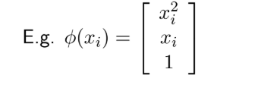
DATA ANALYTICS
NON LINEAR REGRESSION
Central idea of non-linear regression: same as linear regression, just with non-linear features
Two ways to construct non-linear features
Explicitly (construct actual feature vector)
Implicitly (using kernels)

Slide 7
DATA ANALYTICS
NON LINEAR REGRESSION
Nonlinear regression Models
Simple kinetic model
Compartment models
Michaelis Menten reaction
Dose-response relationships

Slide 8
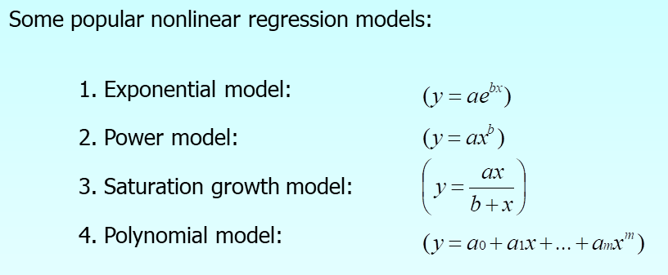
DATA ANALYTICS
NON LINEAR REGRESSION

Slide 9
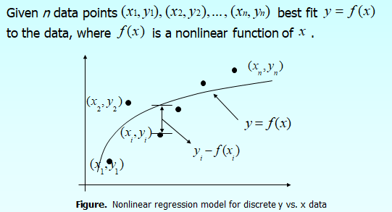
DATA ANALYTICS
NON LINEAR REGRESSION

Slide 10
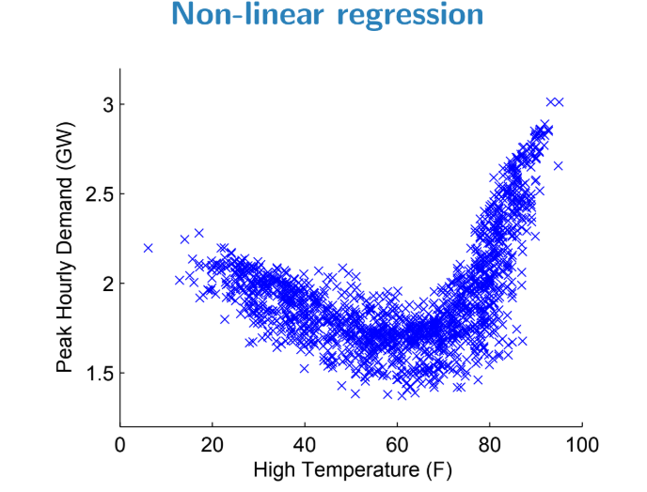
DATA ANALYTICS
NON LINEAR REGRESSION

Slide 11
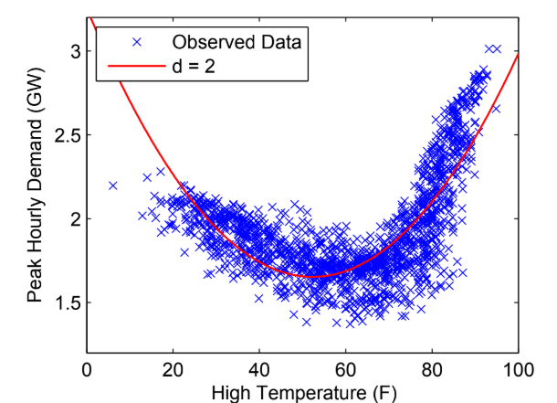
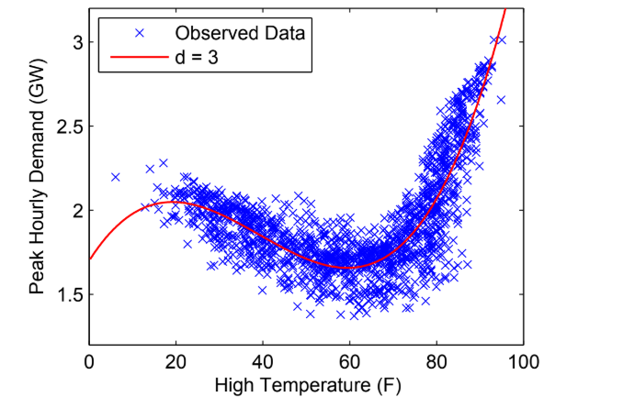
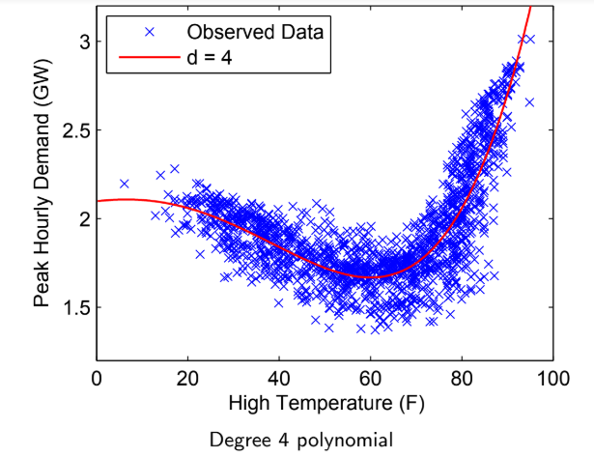
DATA ANALYTICS
NON LINEAR REGRESSION

Slide 12
DATA ANALYTICS
NON LINEAR REGRESSION
Why use non-linear regression?
Transformation is necessary to obtain variance homogeneity, but transformation destroys linearity.
Linearity does not fit, and the transformation seems to destroy other parts of the model assumptions, e.g. the assumption of variance homogeneity.
Theoretical knowledge indicates that the proper relation is intrinsically non-linear.
Interest is in functions of the parameters that do not enter
linearly in the model

Slide 13
DATA ANALYTICS
Polynomial Regression
Polynomial Function: Definition

Slide 14
DATA ANALYTICS
Polynomial Function: Simple Regression

Slide 15
DATA ANALYTICS
Model Form (scalar)

Slide 16
DATA ANALYTICS
Model Form (matrix)

Slide 17
DATA ANALYTICS
PR Model Assumptions (scalar)

Slide 18
DATA ANALYTICS
PR Model: Assumptions (matrix)

Slide 19
DATA ANALYTICS
Polynomial Regression: Properties

Slide 20
DATA ANALYTICS
Polynomial Regression: OLS Estimation

Slide 21
DATA ANALYTICS
Fitted Values and Residuals

Slide 22
DATA ANALYTICS
Estimated Error Variance (Mean Squared Error)

Slide 23
DATA ANALYTICS
Distribution of Estimator, Fitted Values, and Residuals

Slide 24
DATA ANALYTICS
Multicollinearity: Problem

Slide 25
DATA ANALYTICS
Multicollinearity: Partial Solution

Slide 26
DATA ANALYTICS
Orthogonal Polynomials: Definition

Slide 27
DATA ANALYTICS
Orthogonal Polynomials: Orthogonal Projection

Slide 28
DATA ANALYTICS
Orthogonal Polynomials: Gram-Schmidt

Slide 29
DATA ANALYTICS
References
http://users.stat.umn.edu/~helwig/notes/polyint-Notes.pdf

Slide 30
THANK YOU
Dr.Mamatha H R
Professor,Department of Computer Science
mamathahr@pes.edu
+91 80 2672 1983 Extn 834

